Slide 1

PROBLEM SOLVING
The most IMPORTANT skills of the 21st Century

Slide 2
Agenda
Skills of the VUCA World
What is Problem Solving?
How does Problem solving help
Having Fun while solving problems
Steps in Problem Solving (IDEAL Framework)
Approaches to deﬁning Problem Solving
Creating the right mindset for Problem Solving

Slide 3






Mode of Training

Slide 4


If I had 60 minutes to solve a problem, I’d spend 55 minutes deﬁning it, and 5 minute solving it.

Slide 5








Top Skills needed by World Economic Forum (WEF)
Just how important ‘Problem Solving Skills’ is in today’s VUCA world can be estimated from the fact that 5 of the top 10 skills needed for future are related to Problem Solving!!!!!
Think again!
Are you preparing for future
???
** VUCA is an acronym for Volatile, Uncertain, Complex and Ambiguous

Slide 6


What is Problem Solving?
It is a cognitive psychological process of solving complex situations (also called problems)
It is a process of moving towards a goal
when the path to that goal is uncertain
Can be viewed as a tool that can add to the growth not just personal but also for the society
Makes you more valuable. The complex problems you solve, society attaches more value

Slide 7










Examples of Problem Solving
Empower every person
Bring the world closer
World’s transition to electric cars
Organize world’s information and make it universally accessible
Serve consumer through online and physical stores

Slide 8







How does problem solving helps?
Add value to Organization and Society
Move to a higher level and grow
Improves Productivity
Makes you smart and gain conﬁdence

Slide 9





Having Fun with Problems Solving
Do not get intimidated by the word | Take it as Challenge
Encourage asking questions | Explore options
Think Diﬀerently | 360 degrees | Creatively |
Out of Box
Inculcate the Problem Solving Mindset and Attitude
Engage in PS Games | Role Plays | Activities
Take lead | Be Proactive | Act | Start from areas you know

Slide 10
The Staircase Campaign by Volkswagen
Suppose you’ve just taken the subway, and you need to climb up to street level. To exit the station, you can either take the stairs or the escalator. Which one do you use? Although the extra bit of exercise is the healthier choice, many people choose the escalator because of its ease.
Can we change people’s behaviour for the better?

Slide 11
The Staircase Campaign by Volkswagen
In 2009, Volkswagen wanted an innovative way to promote its new environmentally-friendly BlueMotion Technologies brand, which emphasized fuel eﬃciency. Volkswagen partnered with the ad agency DDB Stockholm to devise a creative ad campaign.
They dubbed their marketing campaign “The Fun Theory,” based on the idea that “fun is the easiest way to change people’s behavior for the better.”

Slide 12

The Staircase Campaign by Volkswagen

Slide 13
It isn’t that they cannot see the solution, it is that they cannot see the problem.

Slide 14

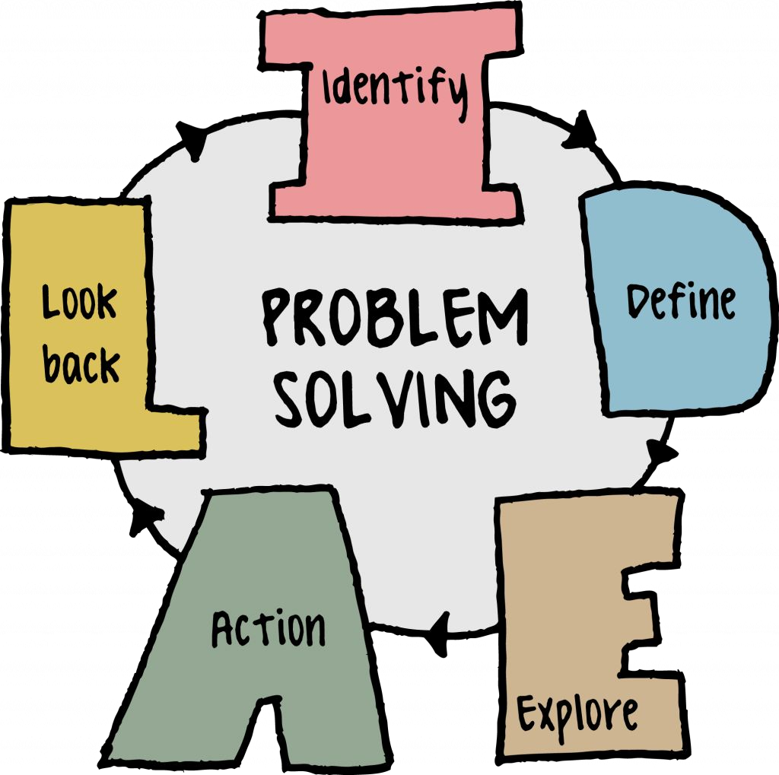
Steps in Problem Solving
Asking the right questions at each step is the Key

Slide 15
Thank You!

Slide 16

Problem Solving with Hunter and Eve

Slide 17
PROBLEM SOLVING
Introduction to MECE

Slide 18

Recap
Introduction to Problem Solving
Real life example - Piano Staircase
IDEAL Framework

Slide 19




Identify
Ask the right questions and analyze the situation carefully to learn more about the problem
Collect information through research and previous experience. Sometimes you would need to analyze the same situation from different perspectives to have a holistic view
Look for indicators or triggers or underlying causes to probe deeper. Differentiate between symptom and a real problem.
Look problems in terms of goals and barriers. Split bigger problems into smaller, manageable and easy to deﬁne
Talk to stakeholders who are impacted. Take notes, combine research insights and create a working deﬁnition

Slide 20
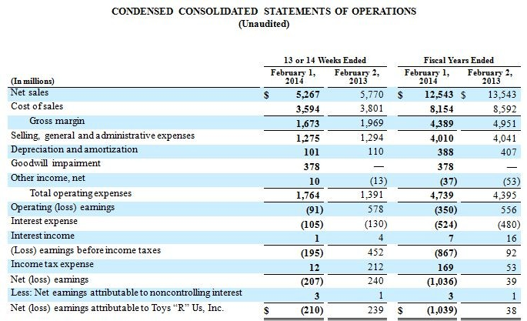
A Negative Proﬁt and Loss Statement

Slide 21





Why deﬁning a Problem Statement is hard?
Symptoms
Blames
Solutions
Personal Biases

Slide 22

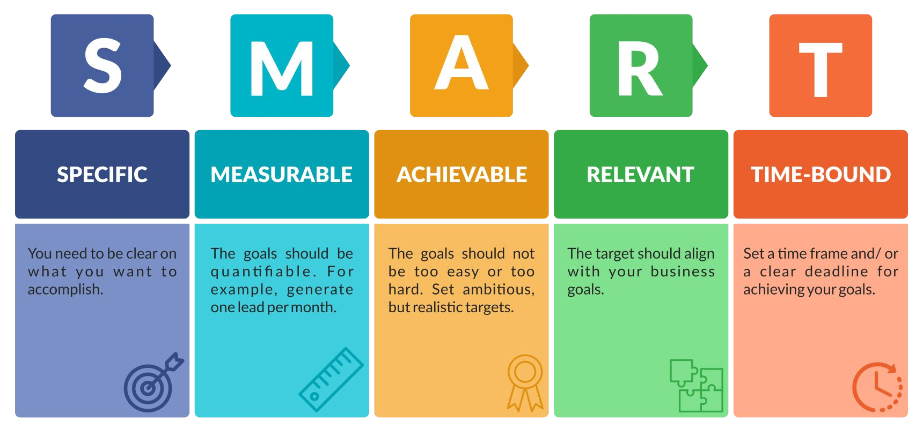
SMART way to deﬁne problem statement

Slide 23


Real Madrid
Royal Madrid Football Club, commonly referred to as Real Madrid, is a Spanish professional football club based in Madrid. Founded in 1902 as Madrid Football Club, the club has traditionally worn a white home kit since its inception. Real Madrid is one of the most widely supported teams internationally. The club was estimated to be worth $5.1 billion in 2022, making it the world's most valuable football team. In 2021, it was the second highest-earning football club in the world, with an annual revenue of €640.7 million.

Slide 24

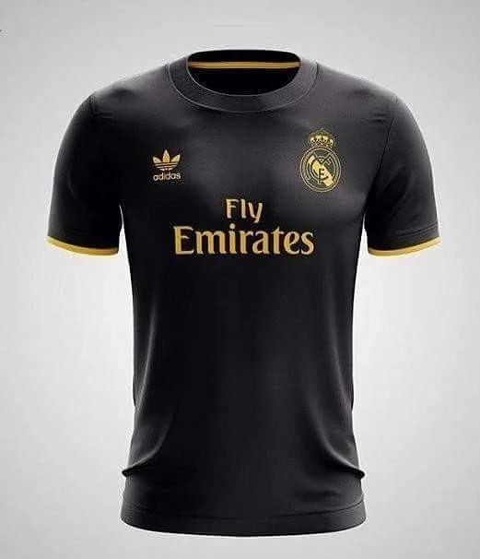
Guesstimates Approach - Exercise (15 mins)
How many Real Madrid jerseys sold in India.

Slide 25




Guesstimates Approach
+
A guesstimate is an estimate or calculation that is based on incomplete or limited information and is therefore not precise or accurate.
It is a combination of the words "guess" and "estimate." A guesstimate is often used when you need to make a rough calculation or estimate without having all the necessary information or data. It may involve using assumptions, past experience, or similar situations to arrive at a rough idea of the answer or outcome.

Slide 26
Guesstimates Approach - Steps
Clearly state what you are trying to estimate or calculate
Gather information especially about the relevant variables
Breakdown the problem into smaller parts (MECE)
Make reasonable assumptions based on experience
Use estimation techniques for each component
Combine estimates for each component

Slide 27

Mutually Exclusive and Collectively Exhaustive
MECE’s full form is Mutually Exclusive Collectively Exhaustive. MECE is often used as a term to break down complex problems into simpler (more comprehensible) problems such that all these
sub-problems don’t overlap and all of these sub-problems, combined together form the problem comprehensively.
Some examples include: The problem of decline in proﬁts can be broken down into subproblems of decrease in revenue or increase in costs. Now, increase in costs don’t depend on decrease in revenues neither does decrease in revenue depend on increase in costs.

Slide 28
Mutually Exclusive and Collectively Exhaustive
Also, Proﬁts equal revenue minus costs, hence these two are the ONLY subproblems that can exist which implies that this is both mutually exclusive and collectively exhaustive.
For example, a company might do a MECE breakdown to evaluate the potential causes of a decrease in sales. The categories might include market factors, competition, product issues, and operational issues. By using a MECE breakdown, the company can ensure that it has considered all relevant factors and can make a more informed decision.

Slide 29
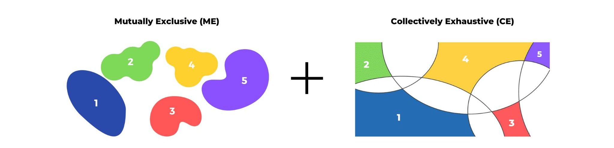
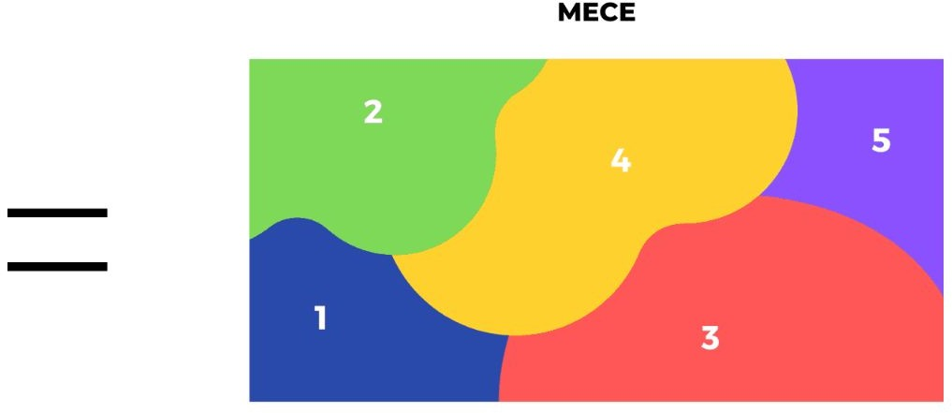
Mutually Exclusive and Collectively Exhaustive

Slide 30
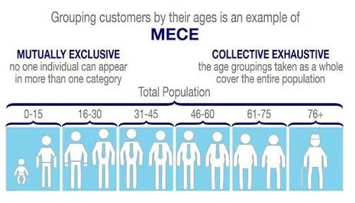
MECE - Example

Slide 31

Guesstimates Approach - Exercise (15 mins)
What are the components in the approach of calculating the Real Madrid jerseys?

Slide 32
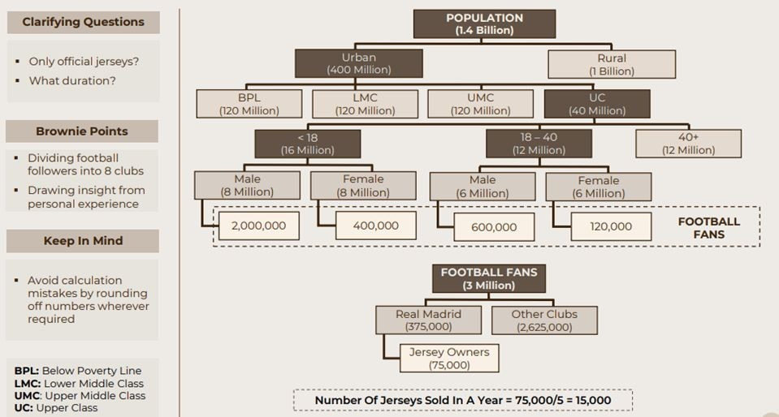
Guesstimates Approach - Exercise (15 mins)
One estimate Guesstimate of Real Madrid

Slide 33
Thank You!

Slide 34
PROBLEM SOLVING
Demand and Supply approach

Slide 35
Recap
Deﬁning a problem statement
Guesstimate Approach
MECE
Real Madrid jersey example

Slide 36

Why MECE?
Eﬃcient
MECE
Facilitates
Compr^{ehensive}
Brainstorming

Slide 37


MECE Frameworks - Maths based
Proﬁts = Revenue (-) Costs
Revenues = Selling Price * Quantity Sold Costs = Variable Cost + Fixed Costs
Revenue Cost
Returns (property) = Price appreciation + Rentals Price appreciation = Selling Price (-) Buying Price Rentals = Monthly Rent * No of Months
Returns

Slide 38

MECE Frameworks - Two Parts
Internal/ External
Direct/ Indirect
Short Term/ Long Term
Supply Side/ Demand Side
Economic/ Non-Economic
Upside/ Downside
Quantitative/ Qualitative
Beneﬁts/ Cost

Slide 39

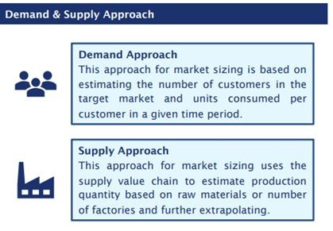

Developing MECE strategy - Demand vs Supply

Slide 40




Demand vs Supply example
Estimate the total number of schools in Mumbai?
Supply Side Approach
Type of schools (govt, private etc)
Are there any govt guidelines on # schools in area like city, town wise, ward etc
Total of each type of school in all the areas (do not forget to be MECE)
Demand Side Approach
Estimate the number of students who want to go to school
Average number of students per school for govt, private etc.
Estimate the total number of each type of schools and add to get the total schools

Slide 41

Demand vs Supply - Phones example
How many phones are sold in India?
Supply Side Approach
●
●
●
Demand Side Approach
●
●
●

Slide 42
Demand vs Supply - Apartment example
How many apartment are sold in Gurgaon in 2022?
Supply Side Approach
●
●
●
Demand Side Approach
●
●
●

Slide 43
Thank You!

Slide 44
PROBLEM SOLVING
Guesstimates: Top - Down Approach

Slide 45
Recap
MECE Frameworks - Math based
MECE Frameworks - Two parts
Demand v/s Supply approach
Guesstimate examples

Slide 46
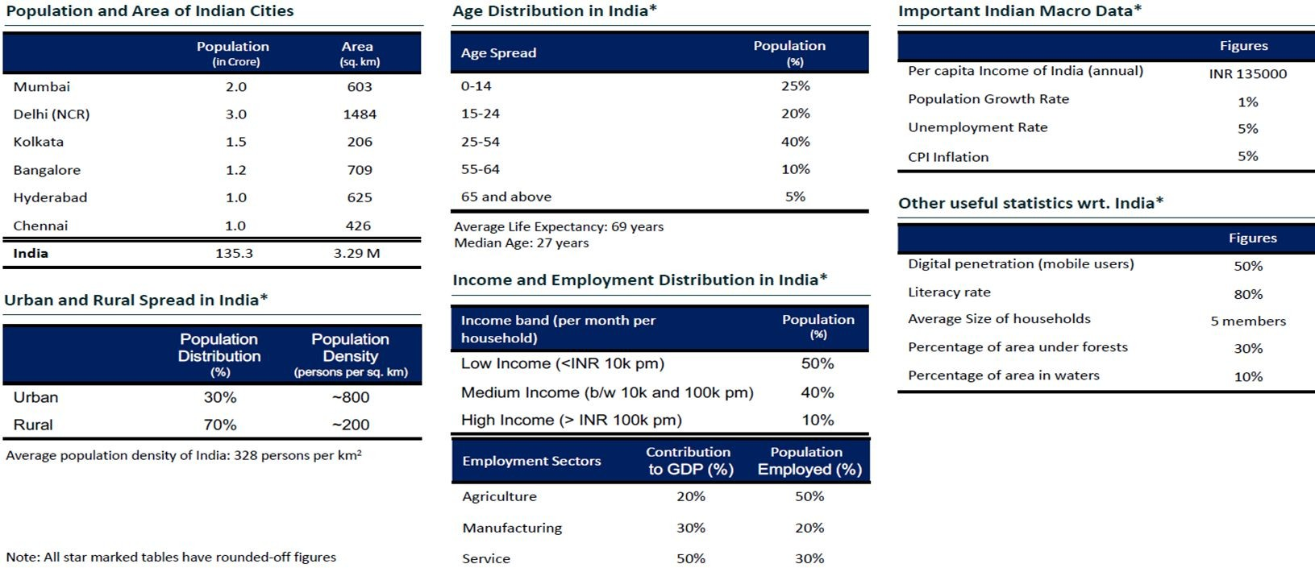
Useful Statistics

Slide 47

Comprehensive Guesstimate Exercises
How many people did morning walk today in Mumbai ?
Supply Side Approach
Demand Side Approach
●
●
●
●
●
●
●
●

Slide 48

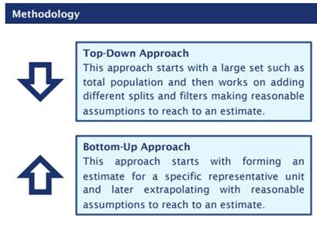


Developing MECE strategy - Top Down vs Bottom Up

Slide 49

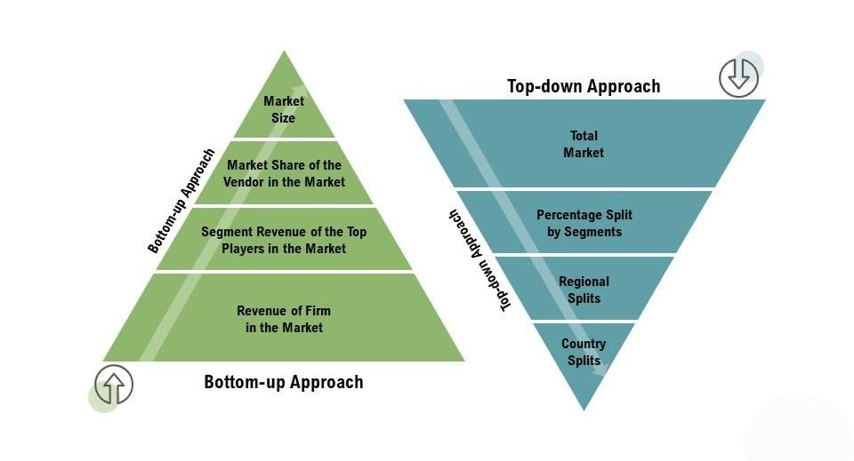
Top Down and Bottom Up approach to Market Analysis

Slide 50

Bottom Up - Examples
Estimate the number of metro trains in New Delhi?
Number of Metro lines X Trains/ line
Estimate the length of an airplane?
Cockpit + Middle body + Tail (end part)
Estimate the returns does the stock of Infosys generate in 5 years?
Price Appreciation + Dividend + Bonus Shares + Rights Issue
Estimate the total books sold by Om Book Shop in NCR region?
Total number of stores X Books sold / store

Slide 51



Deﬁne the Problem Statement
A problem statement is a short, clear explanation of an area of concern or challenge or a condition to be improved upon or diﬃculty to be eliminated that sums up what you want to change. It helps you, team members, and other stakeholders to focus on the problem, why it’s important, and who it impacts.
Should describe an undesirable gap between the current state level of performance and the future state level of performance. It should include absolute or relative measure of problem that quantiﬁes the gap. It should not include a possible cause or solution
Current State
Future State
Gap

Slide 52




Top down vs Bottom Up
How many Apple products are sold in India?

Slide 53
Comprehensive Guesstimate Exercises
How many taxis are operating in India?
Bottom Up Approach
Top Down Approach

Slide 54

Case Statement
Estimate the number of ﬂights operating from the Bengaluru airport in one day?

Slide 55
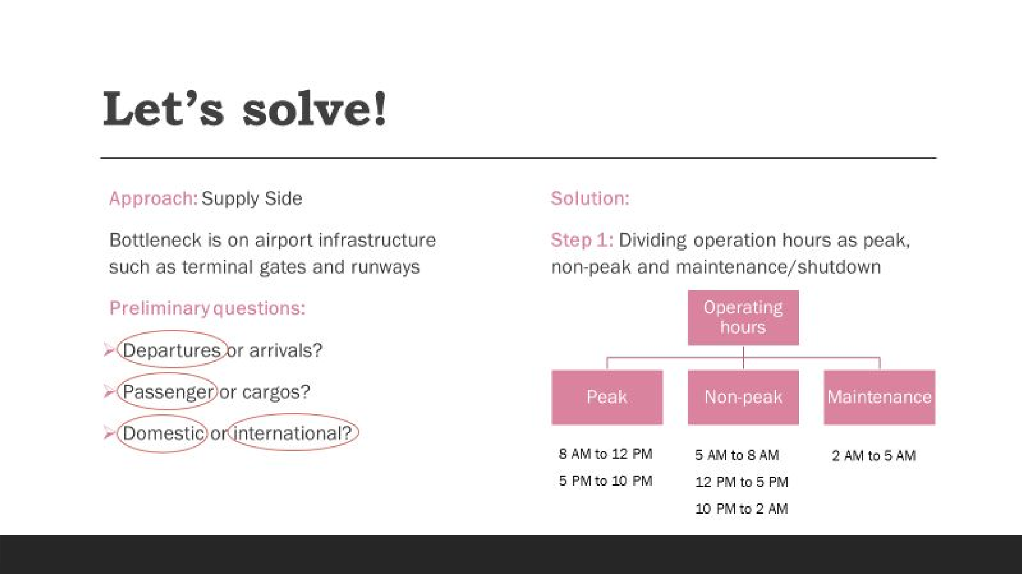

Slide 56
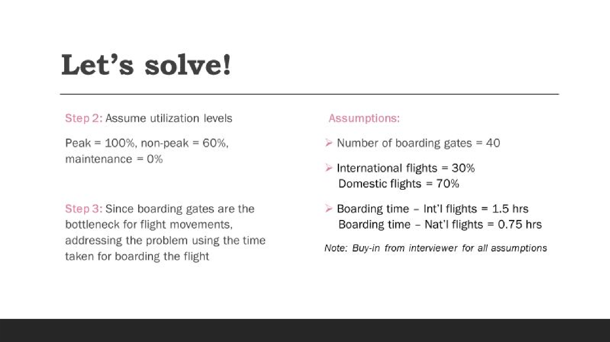

Slide 57
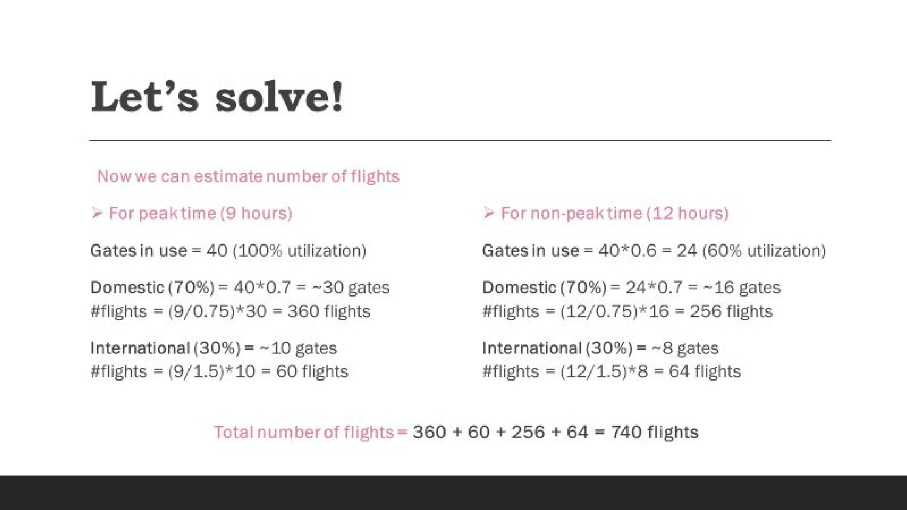

Slide 58
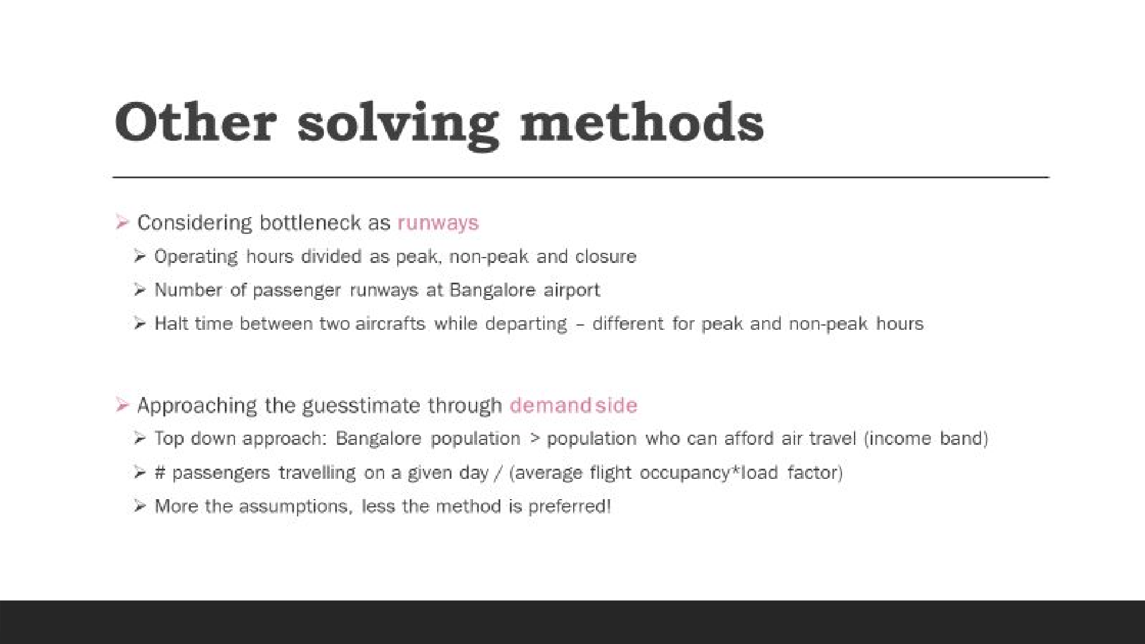

Slide 59
Thank You!

Slide 60
Top down vs Bottom Up
Estimate the proﬁt for tour operator like MakeMyTrip ?

Slide 61
Comprehensive Guesstimate Exercises
How many planes are ﬂying in the world at the moment ?
Supply Side Approach
Demand Side Approach
●
●
●
●
●
●
●
●

Slide 62
Comprehensive Guesstimate Exercises
How many books are sold on Amazon in a month?
Supply Side Approach
Demand Side Approach
●
●
●
●
●
●
●
●

Slide 63
Comprehensive Guesstimate Exercises
How many trees are there in the world?
Bottom Up Approach
Top Down Approach

Slide 64
PROBLEM SOLVING
Concluding Guesstimates

Slide 65
Recap
Demand v/s Supply Approach
Top-down v/s Bottom-up Approach
Example: Number of ﬂights

Slide 66
Developing MECE strategy - Demand vs Supply

Slide 67

Demand or Supply?
Number of burgers sold at McDonalds in a day?

Slide 68

Demand or Supply?
Number of Sugar Free packs sold in India?

Slide 69






5W and 1H approach to Problem Statement
A problem statement must address these six questions to build a clear representation of an issue. Without it, problems may go unnoticed or ignored, leading to larger problems in the future.
What
Define | Understand | Facts | Opinions | Resources
Why
Diagnose | Cause | Explain | Curiosity | Reason
When
Duration | Timing | Before | After
Where
Location | Situation |
Who
People | Stakeholders | Parties involved
How
Method | Process | Approach

Slide 70


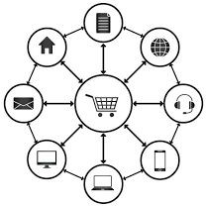







Preliminary Ǫuestions
Geography
Product Mix
Business Model
Consumers
Value Chain
Market Positioning
Competitors
Time Period
How much?
Internal or External

Slide 71

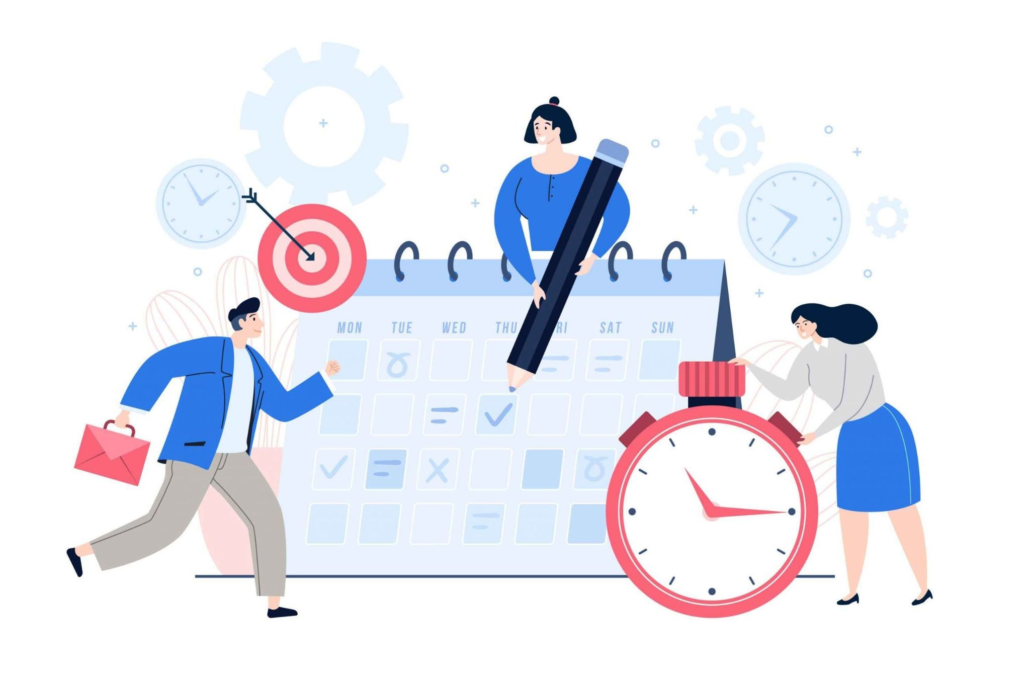
Exercise - Use 5W and H
You're a manager at a company and one of your employees has come to you with a problem. They're having trouble with a
co-worker who's been consistently arriving late to work. Your task is to come up with a solution to this problem.
Take 10 minutes to brainstorm and discuss possible solutions, and then present your solution to the rest of the group.

Slide 72



Explore Alternatives
Analytical, creative problem solving is about creating a variety of solutions, not just one. Often the most obvious answer is not the most eﬀective solution to the problem.
Try to ﬁnd as many solutions as possible. Analyse how each solution relates to the Root Cause and also the symptoms of the problem.
Deciding if diﬀerent solutions can be merged to give a better answer to the problem
Diﬀerentiate between long term and short term. Select and Rank the possible solutions
At this stage it is not about ﬁnding one solution, but eliminating the options that will prove less eﬀective at dealing with both the symptoms and the root cause.

Slide 73


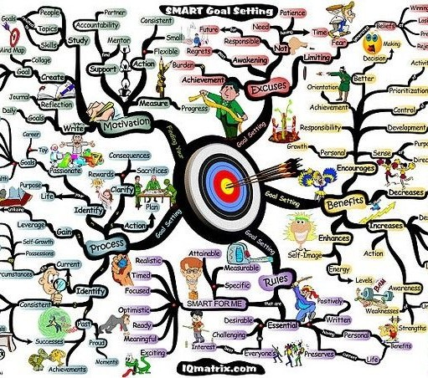



Techniques to explore alternatives
MIND MAPS
BRAINSTORM
RANDOM WORDS GENERATOR

Slide 74


What are Mind Maps
A diagram in which information is represented visually, usually with a central idea placed in the middle and associated ideas arranged around it.
A mind map involves writing down a central theme and thinking of new and related ideas which radiate out from the centre.
By focusing on key ideas written down in your own words and looking for connections between them, you can map knowledge in a way that will help you to better understand and retain information.

Slide 75
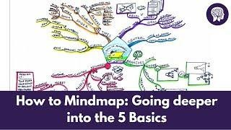
Techniques to explore alternatives - Mind Maps

Slide 76


Activity on Problem Solving - Use Mind Maps
Create a mind map to show what options and alternatives you have if your car is not starting?

Slide 77


Techniques to explore alternatives - Brainstorm
Brainstorming is a group
problem-solving method that involves the spontaneous contribution of creative ideas and solutions
This technique requires intensive, freewheeling discussion in which every member of the group is encouraged to think aloud and suggest as many ideas as possible based on their diverse knowledge.

Slide 78
Brainstorm discussion on Artiﬁcial Intelligence
Brainstorm around the concept of Artiﬁcial Intelligence - a boon or a bane.

Slide 79
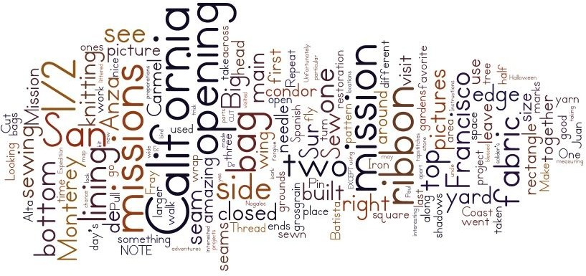
Explore alternatives - Random words generator
By exposing our minds to random words that are unconnected to our problem or challenge, they provoke new associations, much like the ripple that spreads outward in all directions after you drop a pebble into a pond.
The mind loves to make connections, and will do so, no matter how diﬀerent two concepts are from each other. We can use this aspect of the brain’s “wiring” to do our creative bidding.

Slide 80
Explore alternatives - Random words generator
Select a random word: This word must be completely random and unrelated to your problem or challenge. There are several ways to ensure this.

Slide 81
Asking the right questions is today’s world is more valuable than getting the right answers

Slide 82

Recommended Book

Slide 83

Recommended Exercise

Slide 84
Asking the right questions is today’s world is more valuable than getting the right answers.

Slide 85



Let’s solve a Case!
Starbucks outlet revenue?

Slide 86
Starbucks Revenue
Preliminary Questions
Geography?
Business model?
What period?
Approach: Supply side Bottleneck - ordering queue
Solution
Step 1: Dividing operation hours as peak and non-peak
Step 2: Derive a mathematical formula to calculate Starbucks daily revenue
Daily Revenue = # of hours X # of customers per hour X Average spend per customer

Slide 87
Brownie Points?
Other revenue streams
Instant coﬀee powder
Starbucks accessories
Corporate tie-ups
Gift Cards
Parking
What next?
Recommendations: How can the revenue be increased?
What are major cost heads for a Starbucks store?
Can bottleneck be number of seats as people tend to stay for long in Starbucks?
How to optimize operational costs?

Slide 88
Thank You!

Slide 89
Problem Solving
An Introduction to Case Analysis
By: Anshul Bhandari

Slide 90

Recap of the Previous Lecture
How to solve a Guesstimate
Asking preliminary questions
Developing overall strategy
MECE
Demand v/s Supply side
Top-down v/s Bottom-up Approach
Mathematical formula breakdown
Real Madrid jersey example

Slide 91



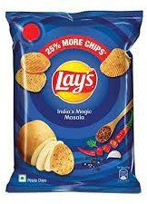
Introduction to Business World!
BUSINESS TERMS
Revenue
Rs 20
Costs
Rs 12
Proﬁt
Rs 8
Loss

Slide 92

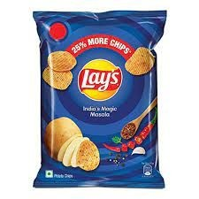
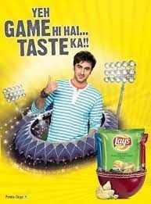
Introduction to Business World!
COST STRUCTURES
Fixed Costs
Plant, Property and Equipment (PPE), etc.
Raw materials cost, Packaging cost, etc. Employee salaries, Advertisement costs, etc.
Variable Costs
Overhead Costs
Depreciation

Slide 93


Introduction to Business World!
FINANCIAL STATEMENTS
Profit and Loss Statement
Revenues and expenses over a period of time
Assets, liabilities and equity at a point of time Cash inﬂows and outﬂows over a period of time
Balance Sheet
Cash Flow Statement

Slide 94

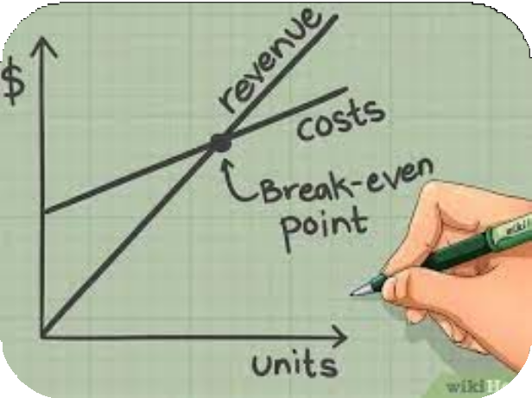
Introduction to Business World!
FINANCIAL PERFORMANCE METRICS
Gross Margin
Net Margin
Return on Investments (RoI)
Break Even Point
Key Performance Indicators (KPIs)

Slide 95
Introduction to Business World!
MARKET and MARKETING
Business
Sales
Entrepreneurship
Marketing
Business Plan
Target Market
Market

Slide 96
























Algebraic Method
Each part of the issue tree is broken down into subparts by using a mathematical formula.
Lets see some examples:

Slide 97


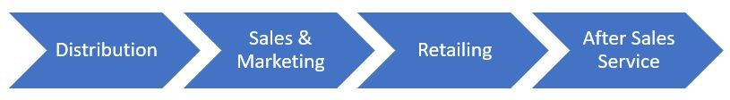
Process Method
Figure out the process causing the issue and think about various stages of the process.
Lets see a manufacturing industry value chain:

Slide 98
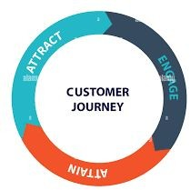
Conceptual Method
Conceptual structures are a bunch of qualitative parameters that we use to divide an issue into.
Lets see some commonly used concepts
PRE
DURING
POST
INTERNAL
EXTERNAL
NEED
AWARENESS
ACCESSIBILITY
AFFORDABILITY
EXPERIENCE

Slide 99
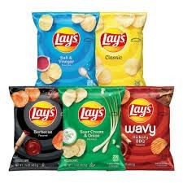
Segmentation Method
We divide the issue into various types of issues based on demographic, geographic, etcetera and then think about the problems in each of these types.
Lets see some segmentations:
Demographics
Gender - Male, Female, Non-binary
Income Segment - Low, Medium, High
Geography
Metro and Non-metro
Product Mix
Diﬀerent ﬂavours of lays

Slide 100
Let’s look through an example-

Slide 101
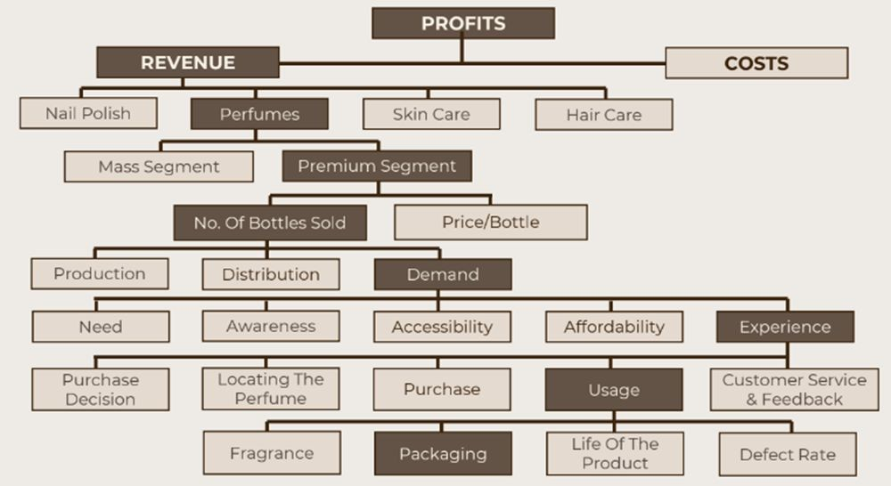
The sales for a makeup brand are decreasing. Figure out why.
Algebraic
Segmentation
Segmentation
Algebraic Process
Conceptual
Conceptual Segmentation

Slide 102
The sales for a makeup brand are decreasing. Figure out why.
At Level 1 & 4, we have used algebraic structure to break down profits into revenues minus costs, and break down revenues from the premium segment into the number of bottles sold multiplied by the price per bottle.
At Level 5, we have broken down the issue of reduction in the number of bottles sold using the
process structure of production, distribution and then demand.
At Level 6, we have used conceptual structures to break the issues of reduction in demand and usage respectively by dividing them into parameters of need, awareness, accessibility, affordability and fragrance, packaging, life, and defect rate.
Lastly, in Level 2, we have segmented the issue of decline in revenues into revenues from nail polish, perfumes, skin care and Hair care.

Slide 103

Ways to be MECE:
To break down the problem and business situation to find the root cause, we need to learn the breakdown technique, that is breaking down any situation into MECE.
Algebraic
Process
Conceptual
Segmentation

Slide 104
Thank You!

Slide 105
Looking into Proﬁts:
A typical profitability problem would look like:
“Your profits are down by 20%, analyse the reason for the same by isolating the problem.”
It is important to begin by understanding the problem better by asking some preliminary questions. Some important preliminary questions for profitability cases are :
Since when has the client been facing the problem and what is the magnitude of the decline?
Where is the client located – Geographically?
Which part of the value chain does our client lie in?
Is it a company-specific or an industry-wide problem?
Segmentation questions – All stores? All geographies? All product lines? All customers?

Slide 106
The problem could stem from the revenue side or the cost side or both.
Proﬁt
Revenue
Cost
Revenue side can be affected by production, distribution and demand.
Revenue
# units sold
Price/Unit
Production
Distribution
Demand

Slide 107
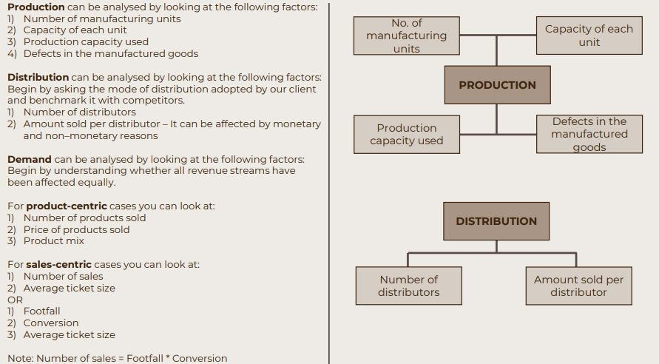

Slide 108
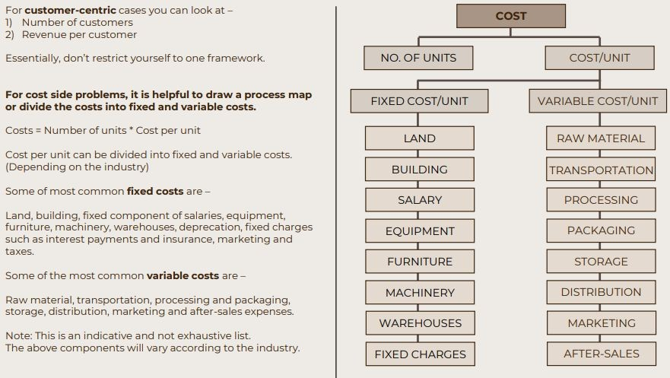

Slide 109
Problem Solving
An Introduction to Proﬁtability Cases
By: Anshul Bhandari

Slide 110

Recap of the Previous Lecture
Business Terminologies
Ways to MECE
Algebraic Method
Process Method
Conceptual Method
Segmentation Method
Make-up brand example (declining proﬁts)

Slide 111
Let’s look at one more example:
Wonka Industries has been facing declining profits in the last 2 months.
He has hired you, a famous connoisseur of candy, to solve his woes.

Slide 112
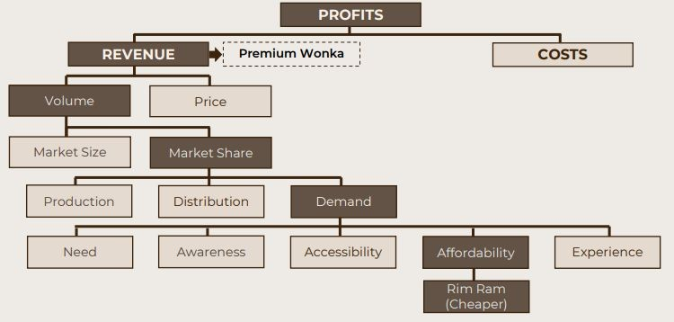
Wonka Industries
Algebraic
Algebraic
Algebraic
Process
Conceptual

Slide 113
Let’s solve a Case!
Starbucks outlet revenue?

Slide 114
Starbucks Revenue
Preliminary Questions
Geography?
Business model?
What period?
Approach: Supply side Bottleneck - ordering queue
Solution
Step 1: Dividing operation hours as peak and non-peak
Step 2: Derive a mathematical formula to calculate Starbucks daily revenue
Daily Revenue = # of hours X # of customers per hour X Average spend per customer

Slide 115
Brownie Points?
Other revenue streams
Instant coﬀee powder
Starbucks accessories
Corporate tie-ups
Gift Cards
Parking
What next?
Recommendations: How can the revenue be increased?
What are major cost heads for a Starbucks store?
Can bottleneck be number of seats as people tend to stay for long in Starbucks?
How to optimize operational costs?

Slide 116
Preliminary Ǫuestions
Geography
Product Mix
Business Model
Consumers
Value Chain
Market Positioning
Competitors
Time Period
How much?
Internal or External

Slide 117
Let’s do one more case
Your client is Airport Authority of India. They are concerned about the declining revenue in the Bangalore Airport. They would like to analyze you why this may be happening and give suitable recommendations

Slide 118
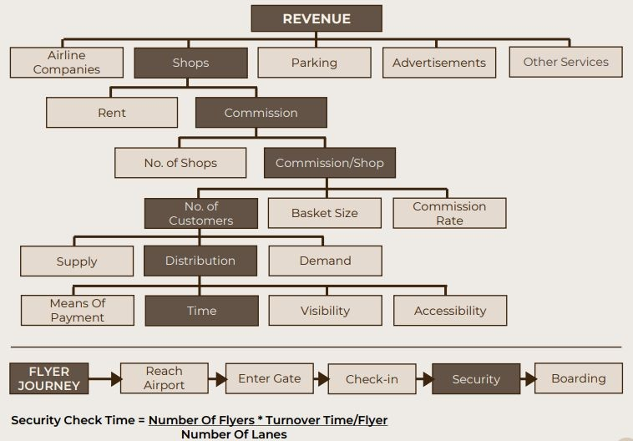

Slide 119
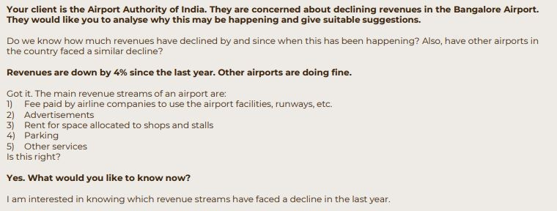
Case Interview Script

Slide 120
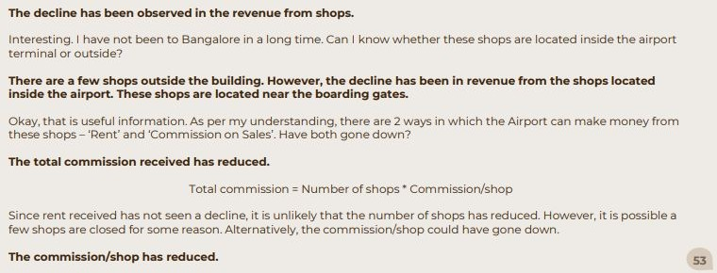
Case Interview Script

Slide 121
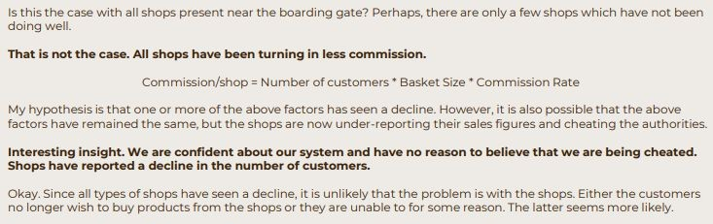
Case Interview Script

Slide 122
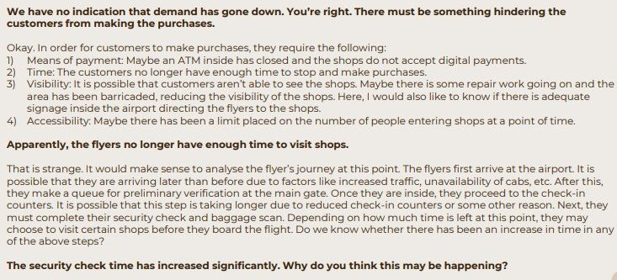
Case Interview Script

Slide 123
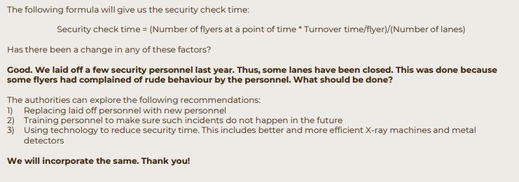
Case Interview Script

Slide 124
Thank You!

Slide 125
Take-home case
Estimate the number of ﬂights operating from the Bengaluru airport in one day?

Slide 126
Problem Solving
More on the Proﬁtability Cases
By: Anshul Bhandari

Slide 127
Recap of the Previous Lecture
Art of asking preliminary questions
Applications of MECE breakdown to Proﬁt Cases
Case Analysis: Airport Authority of India

Slide 128
Let’s do another case
Hypermarket Operations
Your client is a grocery retailer having multiple stores across the country. They are facing low proﬁts in individual stores as compared to the competition. Find the issue and recommend solutions.

Slide 129
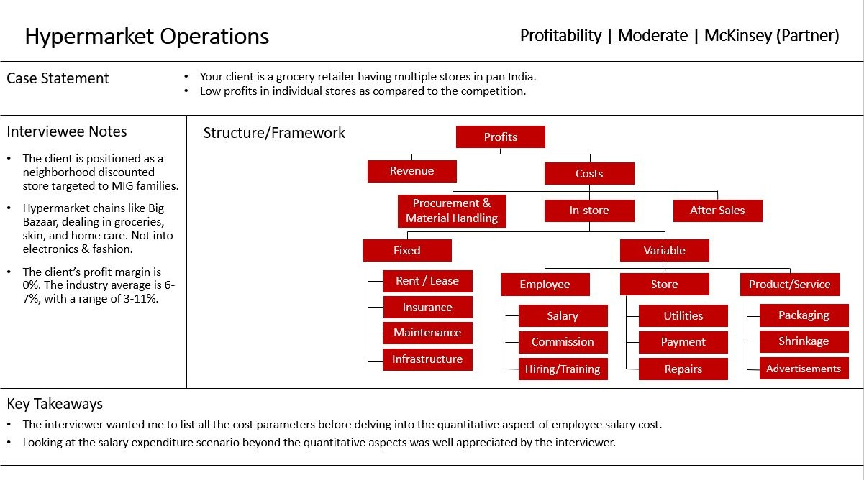

Slide 130
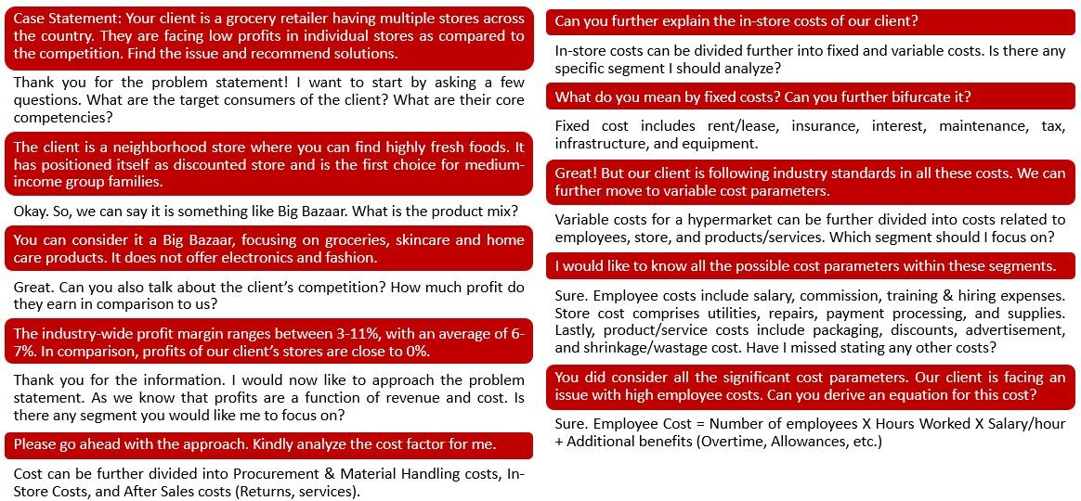
Case Interview Script

Slide 131
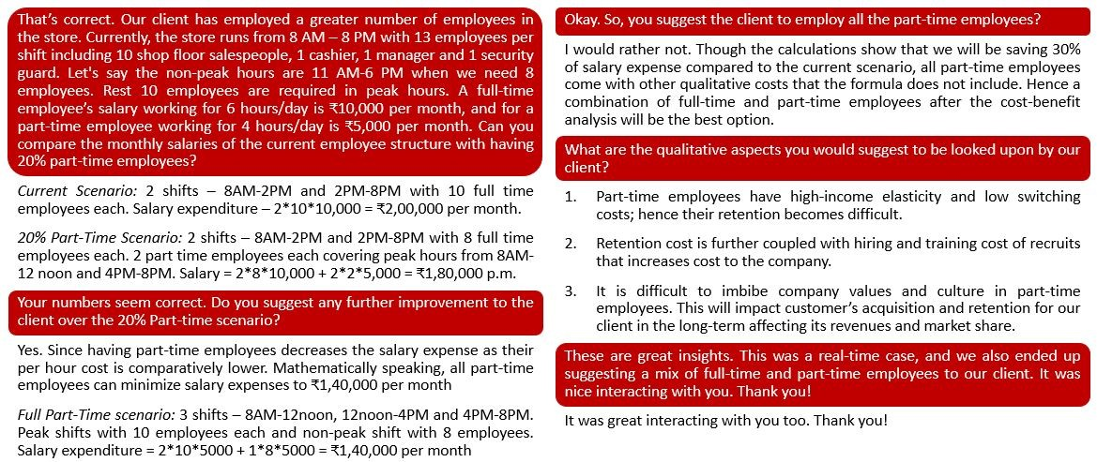
Case Interview Script

Slide 132
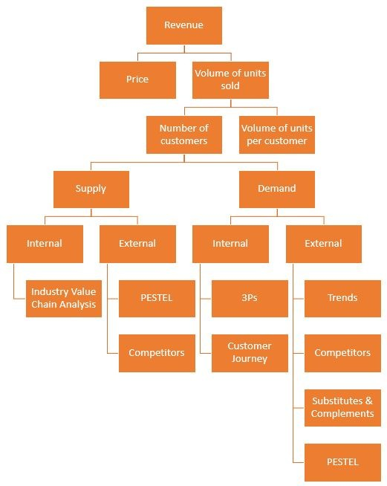
Revenue Analysis

Slide 133
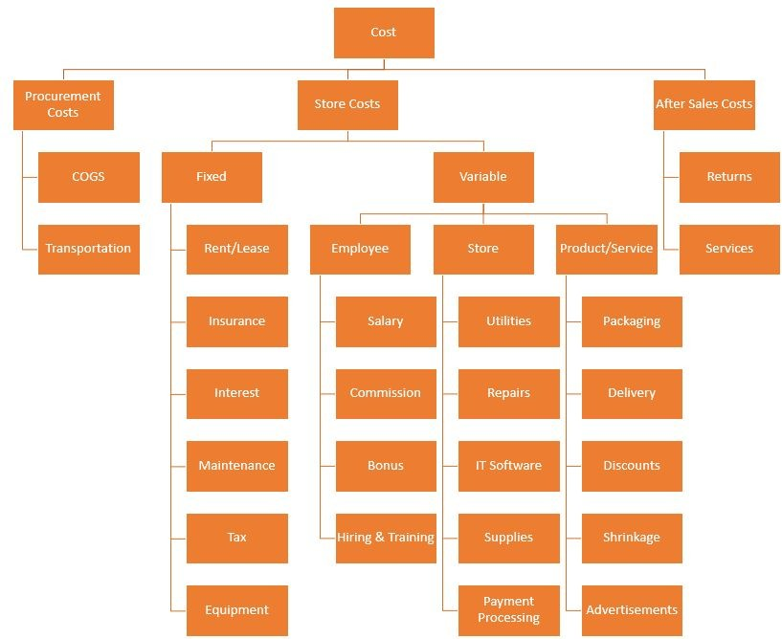
Cost Analysis
(Services Industry)
restaurants, salons, supermarkets, boutiques

Slide 134
Let’s do another case
Toy Story
The year is 2021. Your client is a toy manufacturer and has been facing a decline in revenue in the past 1 year. You need to analyse why this is happening.

Slide 135
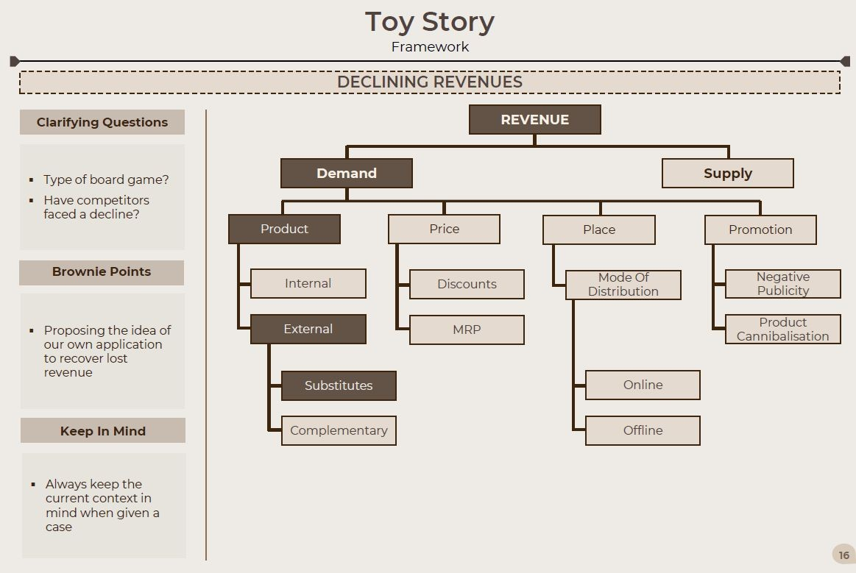

Slide 136
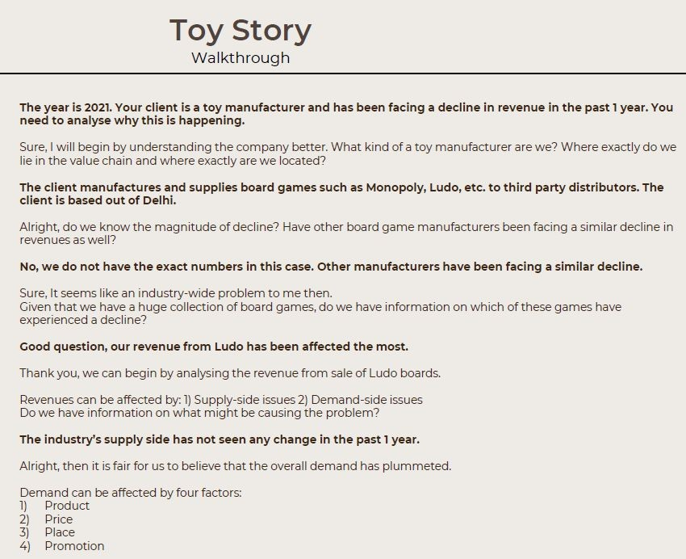
Case Interview Script

Slide 137
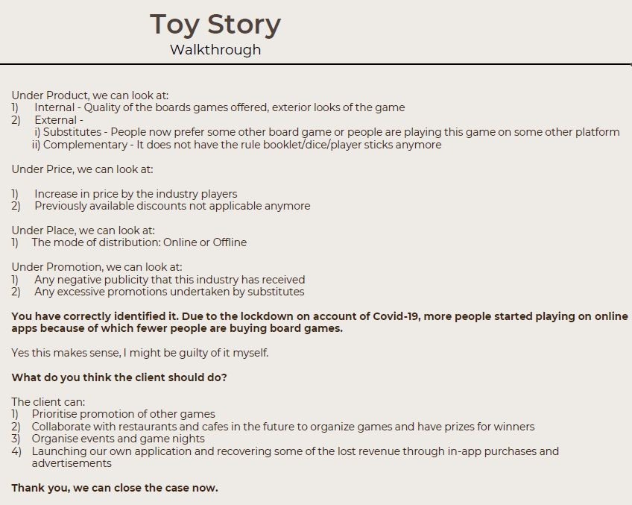
Case Interview Script

Slide 138
Thank You!

Slide 139
Try one more problem with the same process:
Your client is a toﬀee manufacturer and has seen a decline in proﬁts from the past one year. Figure out way?

Slide 140

First things ﬁrst!
Asking the preliminary questions
Geography
Product Mix
Business Model
Consumers
Value Chain
Already mentioned
Time Period
How much?
Already mentioned
Competitors

Slide 141
First things ﬁrst!
Asking the preliminary questions
Geography
Maharashtra
Product Mix
All type of electronics
Business Model
Typical Industry
Consumers
Middle class
Value Chain
Already mentioned
Time Period
How much?
Already mentioned
Competitors
Doing great
10% decline in proﬁts

Slide 142
Step 2: Breaking down a MECE structure
Proﬁt
Revenue
—
Costs
Haven’t changed
Gone up by 10%
Write down all the Cost incurred following the process value chain
Fixed Costs
+
Variable Costs
Organizational Costs
+
Operational Costs

Slide 143
Fixed Costs
Variable Costs
Land
Infrastructure
Debt
Equipment
R&D
Licensing
Approvals etc.
Organizational Costs
+
Operational Costs
Salary
Rent
Advertisement
Marketing
Distributor
Incentives/ Oﬀers
Customer
Acquisition
Training
Raw material
Transport
Processing
Packaging
Storage
Wastage
Transport
Discounts
Energy Costs
Eﬃciency
Repairs
Returns etc.

Slide 144
Your client is a toﬀee manufacturer and has seen a decline in proﬁts from the past one year. Figure out way?
Proﬁt
Gone down by 25%
Revenue
—
Costs
Haven’t changed
#units sold
X
Revenue/unit
Haven’t changed
Supply Side
Demand Side
Issue Identiﬁcation Step
Now think of a conceptual breakdown for this (MECE). Ask questions

Slide 145
Your client is a toﬀee manufacturer and has seen a decline in proﬁts from the past one year. Figure out way?
Proﬁt
Gone down by 25%
Revenue
—
Costs
Haven’t changed
#units sold
X
Revenue/unit
Haven’t changed
Supply Side
Demand Side
Issue Identiﬁcation Step
Who do we sell to? If multiple categories then, is the decline constant among all categories?
What are the distribution channels?

Slide 146
Problem Solving
Introduction to Market Entry Cases
By: Anshul Bhandari

Slide 147
Recap of the Previous Lecture
Proﬁtability Case - Hypermarket Operations
Detailed Frameworks
Revenue Analysis
Cost Analysis (Service Industry)

Slide 148
Objectives of Market Entry case studies
Understand the concept of market entry
Market entry and data analytics
Learn about diﬀerent market entry strategies
Explore real-life market entry case studies

Slide 149



Preliminary Ǫuestions
Objective
Product Mix
Time Period
Product Diﬀerentiation
Company
Market Positioning
Competitors
Similar market/expansion
Geography
Consumers

Slide 150
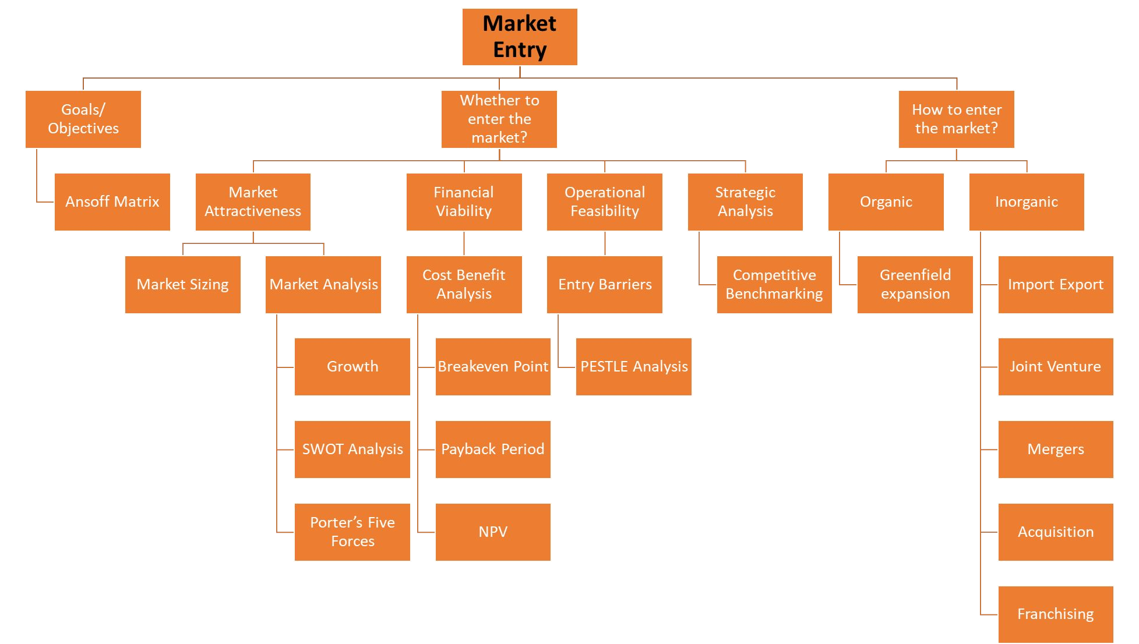

Slide 151
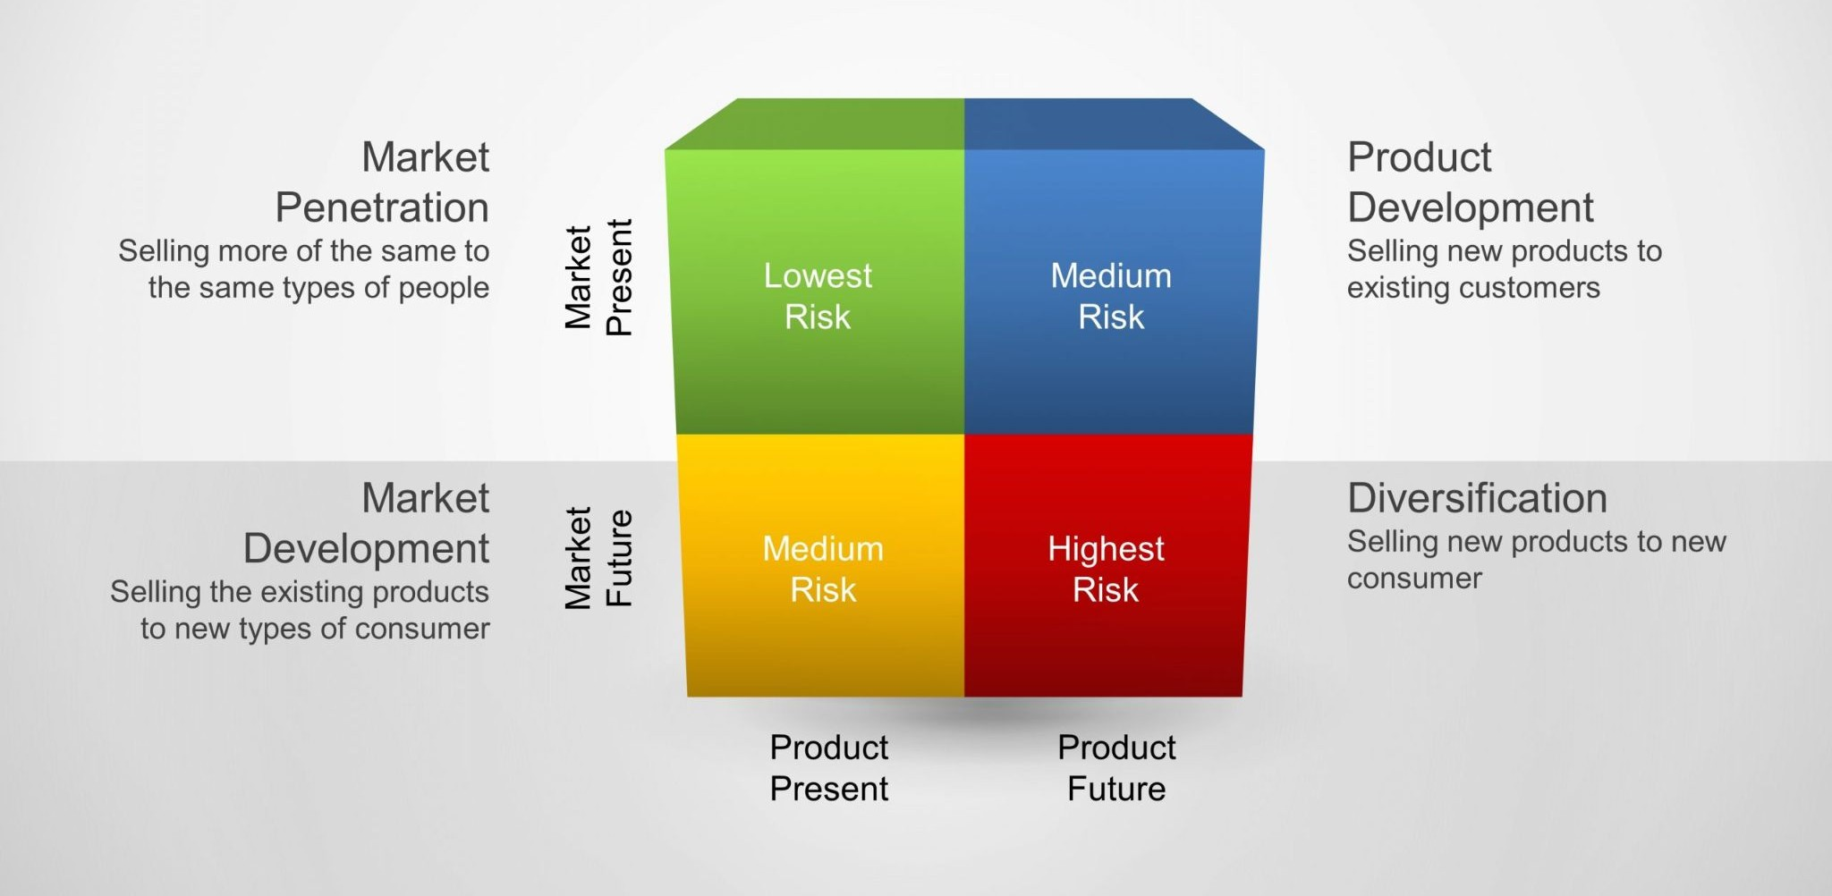
Ansoff Growth Matrix

Slide 152
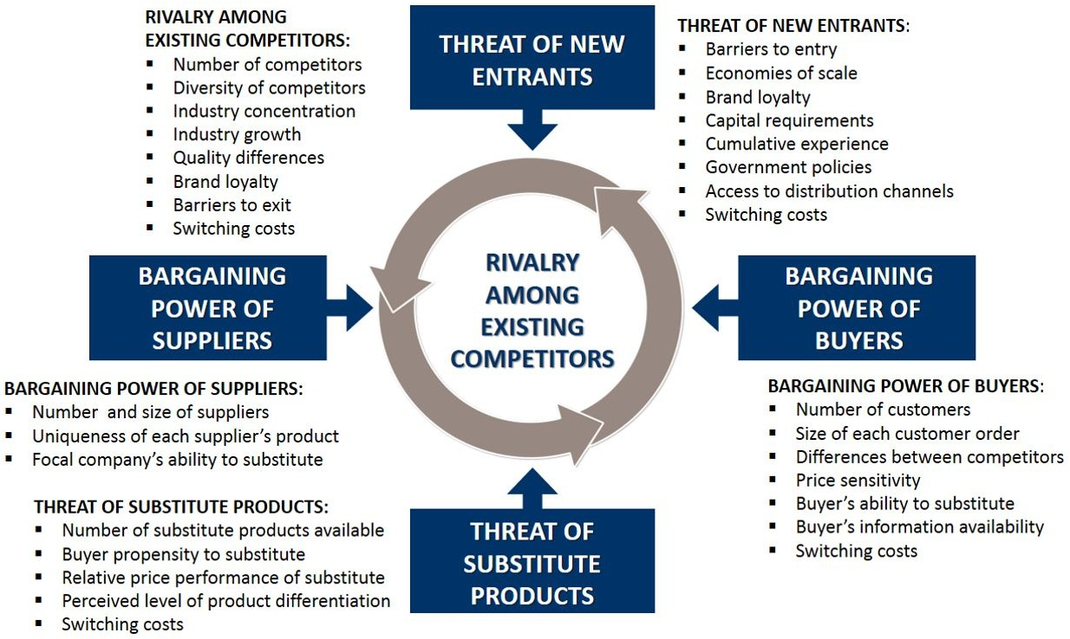
Porter’s Five Forces

Slide 153
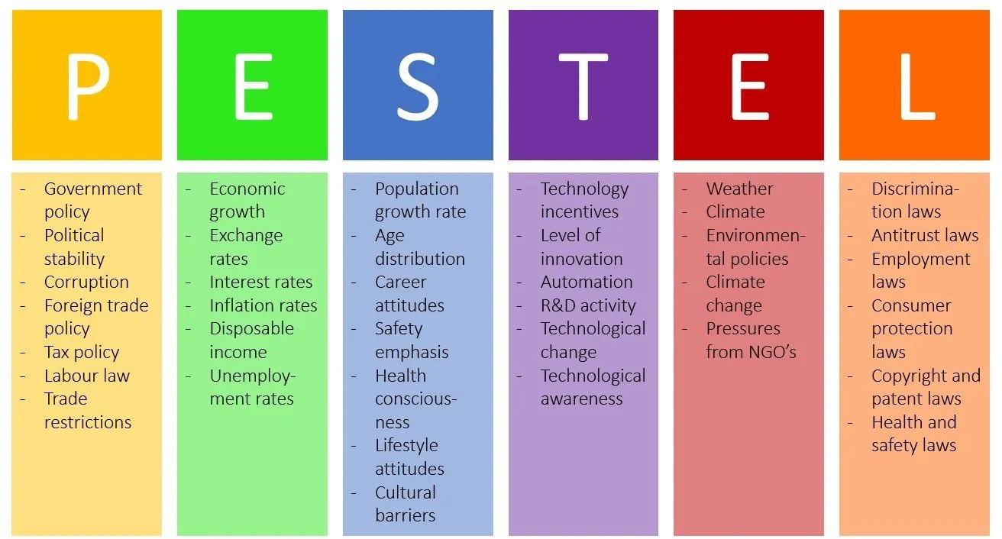
PESTEL
Political
Economic
Social
_{Technological} Environmental
Legal

Slide 154

SWOT Analysis

Slide 155
Let’s solve a case
HBS Satellite Campus
HBS wants to set up a new satellite campus in India. They want your advice about the proposal.

Slide 156


Slide 157
Thank You!

Slide 158


Slide 159


Slide 160


Slide 161
Porter’s 5 forces –
Threat of new entry (Barriers to Entry)
Government Regulation, High Capital Requirements, R&D – IP/Patent, High Brand Equity, Human Capital, High Costs, Economies of scale/scope, Switching costs – Network Eﬀects, Distribution Network
Competitive Rivalry
Consolidated/Fragmented Market, Market Share distribution among competitors, Supplier/Distributor, Channel – Strength & Weakness, Contractual customer lock-ins deﬁne market trends
Buyer Power
Segment Growth, WTP – f(demand), Distributor Channel Preference (Outbound Logistics), Demand
<-> Supply Gap (Important), Price Sensitivity – Ascertains whether to go for Premium Pricing or not, Threat of forward integration – VERY HIGH SUPPLIER POWER, Needs w.r.t current product mix being oﬀered in the market
Threat of Substitution (Value Chain & Substitute products)
Switching cost of buyers/suppliers, Threat of backward integration – Competition might acquire vendors to control its supplies of RM et al., Manufacturing Resources – Talent/Expertise availability, Availability of substitute products, Consumer Behavior evolutionary trends
Supplier Power
Number of suppliers relative to buyers, Dependence of a supplier’s sale on a particular buyer, Switching costs of buyers, Forward integration

Slide 162

ANSOFF MATRIX

Slide 163
Problem Solving
Introduction to Pricing
By: Anshul Bhandari

Slide 164

Recap of the Previous Lecture
Market Entry Case Studies - Objectives
Concepts
Ansoﬀ Growth Matrix
Porter’s Five Forces
PESTEL
SWOT Analysis
Case: HBS Satellite Campus

Slide 165
What and Why Pricing?
Pricing problems typically require you to help determine the price of a product for a company.
This product is, more often than not, an innovation or patented product that is being introduced for the first time.
A typical problem would be
“Your client has introduced a new drink that helps cure balding. Help them develop an appropriate price for the product.”

Slide 166
Preliminary Ǫuestions
Objective
Product Mix
Time Period
Product Diﬀerentiation
Company
Market Positioning
Competitors
Similar market/expansion
Geography
Consumers

Slide 167

Preliminary Ǫuestions

Slide 168






Pricing Framework
Highest price that can be charged
Lowest price to be charged

Slide 169
Types of Pricing
Cost-Based: The lower limit of the price you can charge. Under this method, you identify the various costs associated with the product and arrive at the cost required to produce one unit. This sets the lower limit as any price below this would mean costs are higher than revenues leading to losses.
Note: The trick with this step is to estimate the appropriation of the fixed cost per product/service. It is always important to ask or what period or over how many products does the manufacturer want to recover their fixed costs.

Slide 170
Types of Pricing
Value-based: The upper limit of the price you can charge. In this method, you need to put your thinking caps on! The aim of this method is to estimate the maximum amount customers would be willing to pay for your product/service. The best way to do this would be to compare it to the substitutes the competitor might use to get the same level of satisfaction.
Competitor-based: The range of the price you can charge. Under this method, you need to compare the price competitors are charging for providing a similar product/service. This gives you a rough range of the price you can charge, since the aim is to be competitive. Note: It is important at this step to differentiate between our product/service and that of the competitors. If we provide a better product with more features, we will be justified in charging a higher price.
Demand-Supply-based: An alternative method for pricing. Also known as price-elasticity method, this method is really uncommon and can only be used if the interviewer has prior information regarding the various demand-supply points of the product/service. The goal of this method is to choose the price point that maximizes either profits or revenues.

Slide 171


Slide 172
Problem Solving
Guesstimates, Market Entry and Pricing
By: Anshul Bhandari

Slide 173

Recap of the Previous Lecture
Pricing
Introduction
Preliminary Question
Framework
Types of Pricing
Case: Luxury Yacht Pricing

Slide 174
Mutually Exclusive and Collectively Exhaustive
MECE’s full form is Mutually Exclusive Collectively Exhaustive. MECE is often used as a term to break down complex problems into simpler (more comprehensible) problems such that all these
sub-problems don’t overlap and all of these sub-problems, combined together form the problem comprehensively.
Some examples include: The problem of decline in proﬁts can be broken down into subproblems of decrease in revenue or increase in costs. Now, increase in costs don’t depend on decrease in revenues neither does decrease in revenue depend on increase in costs.

Slide 175
Mutually Exclusive and Collectively Exhaustive
Also, Proﬁts equal revenue minus costs, hence these two are the ONLY subproblems that can exist which implies that this is both mutually exclusive and collectively exhaustive.
For example, a company might do a MECE breakdown to evaluate the potential causes of a decrease in sales. The categories might include market factors, competition, product issues, and operational issues. By using a MECE breakdown, the company can ensure that it has considered all relevant factors and can make a more informed decision.

Slide 176

Mutually Exclusive and Collectively Exhaustive

Slide 177
MECE - Example

Slide 178


MECE Frameworks - Maths based
Proﬁts = Revenue (-) Costs
Revenues = Selling Price * Quantity Sold Costs = Variable Cost + Fixed Costs
Revenue Cost
Returns (property) = Price appreciation + Rentals Price appreciation = Selling Price (-) Buying Price Rentals = Monthly Rent * No of Months
Returns

Slide 179

Developing MECE strategy - Demand vs Supply

Slide 180




Demand vs Supply example
Estimate the total number of schools in Mumbai?
Supply Side Approach
Type of schools (govt, private etc)
Are there any govt guidelines on # schools in area like city, town wise, ward etc
Total of each type of school in all the areas (do not forget to be MECE)
Demand Side Approach
Estimate the number of students who want to go to school
Average number of students per school for govt, private etc.
Estimate the total number of each type of schools and add to get the total schools

Slide 181

Developing MECE strategy - Top Down vs Bottom Up

Slide 182

Top Down and Bottom Up approach to Market Analysis

Slide 183

Top Down and Bottom Up approach to Market Analysis

Slide 184
Useful Statistics

Slide 185
Thank You!

Slide 186
Problem Solving
The D-day!
By: Anshul Bhandari

Slide 187
Recap of the Previous Lecture
MECE
What is MECE - with examples
Demand & Supply approach
Top-down & Bottom-up approach
Case: Anti smoking pill

Slide 188
Market Entry

Slide 190
Guesstimate Case
# of four-wheeler tyres

Slide 191


Slide 192
Case: Don’t steel from us!
Your client is a steel manufacturing company. You are required to diagnose why the company’s costs have increased by 4% in the last 6 months.

Slide 193


Slide 194


Slide 195


Slide 196


Slide 197
Thank You!

